Slide 1

Battery jig test

Slide 2
Problem:
Measure battery voltage for battery.
Control printing labels for only the passed items.

Slide 3
Objectives:
Test all batteries voltage and check it’s passed or not.
automate and control labels printing for passed items with desktop application.

Slide 4
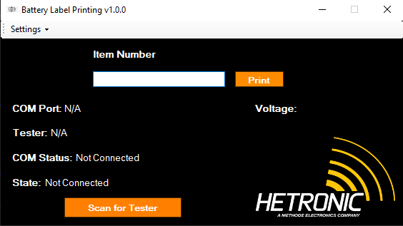
Desktop Application:

Slide 5
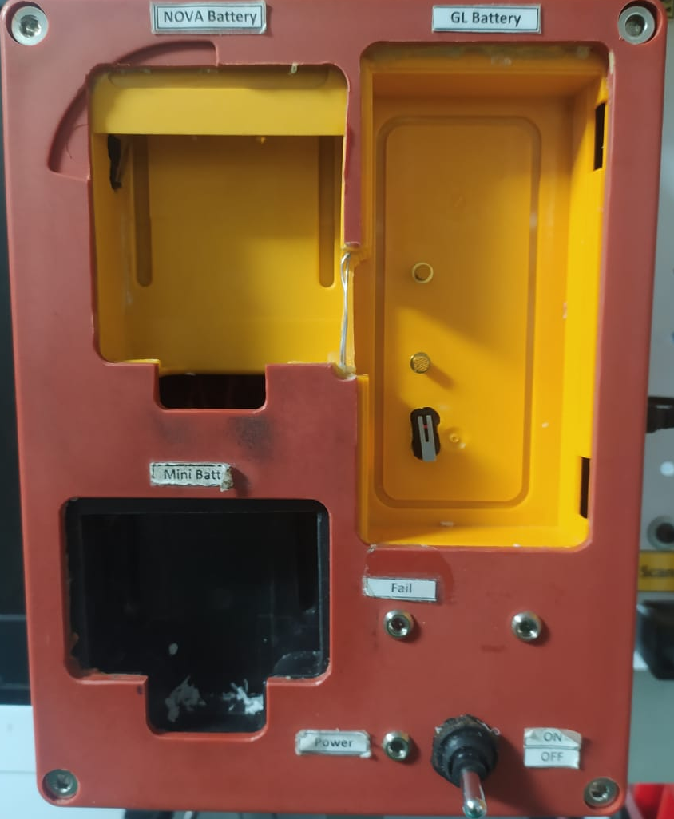
Testing Jig:

Slide 6
Thank You

